Slide 1
REVISED CHANGES TO ADDITIONAL HTS
Including Revised IEEPA, Section 301, Section232

Slide 2
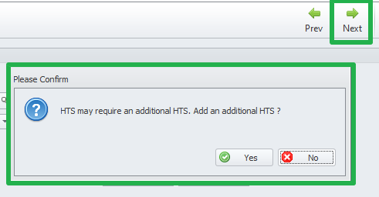
Notes to remember
During Entry line review the following pop up will appear. Select Yes to obtain additional line.

Slide 3
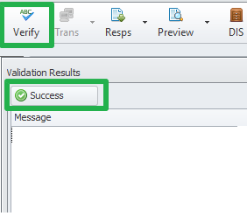
Notes to remember
All duty calculations will be done at the end after a successful local verify process:

Slide 4
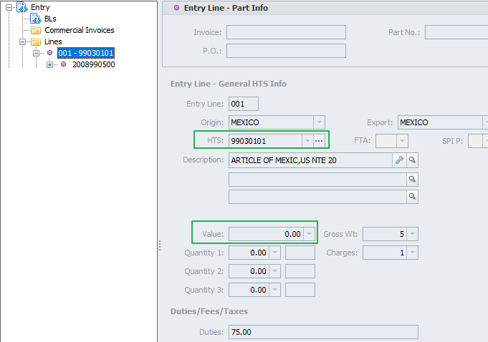
Scenario 1 - Section IEEPA and 1-97 HTS MX ORIGIN
MX Origin Section IEEPA goes first
Value is 0

Slide 5
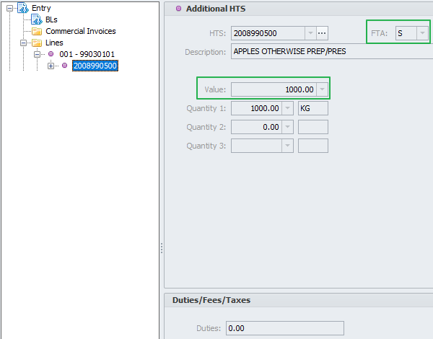
Scenario 1 - Section IEEPA and 1-97 HTS MX ORIGIN
1-97 HTS goes last
Include dutiable value on this line
If USMCA applies “S” will go here.
Please note that USMCA will not reduce the 9903 duty

Slide 6
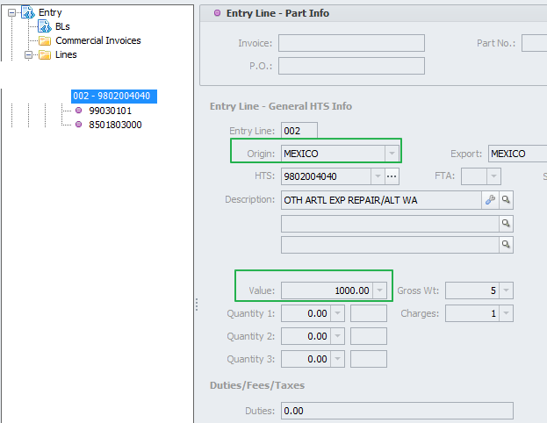
Scenario 2 – Repair 98020040/50 , Section IEEPA, 1-97 HTS Dutiable Repair MX Origin
9802 repair HTS goes first
Must include Value of product excluding repair value
This value is non dutiable

Slide 7
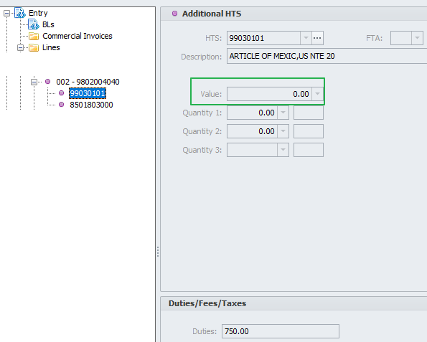
Scenario 2 – Repair 98020040/50 , Section IEEPA, 1-97 HTS Dutiable Repair MX Origin
MX Section IEEPA goes second
Value is 0

Slide 8
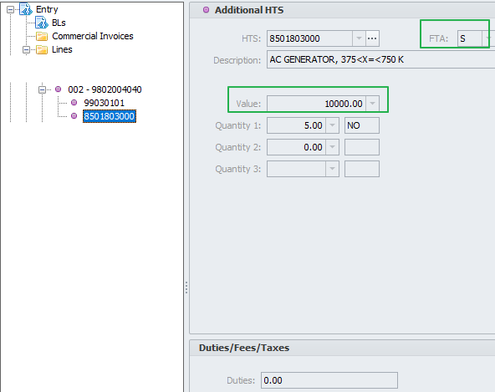
Scenario 2 – Repair 98020040/50 , Section IEEPA, 1-97 HTS Dutiable Repair MX Origin
1-97 HTS goes last
Include dutiable value on this line
If USMCA applies “S” will go here.
Please note that USMCA will not reduce the 9903 duty

Slide 9
Scenario 3 - Section IEEPA and 1-97 HTS CN Origin
CN Section IEEPA goes first .
Please note that after 3/4/25 HTS 99030124 applies
Value is 0

Slide 10
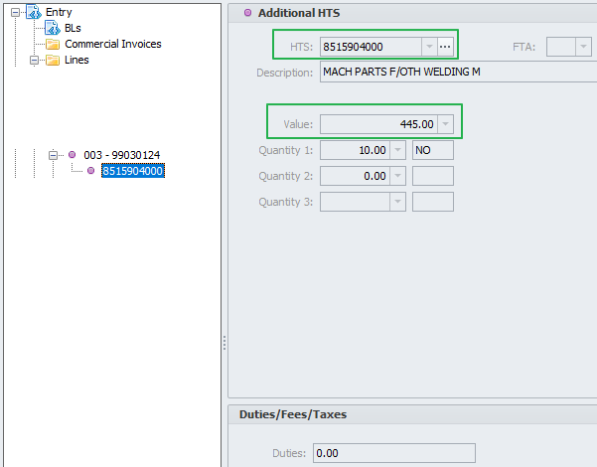
Scenario 3 - Section IEEPA and 1-97 HTS CN Origin
1-97 HTS goes last
Include dutiable value on this line

Slide 11
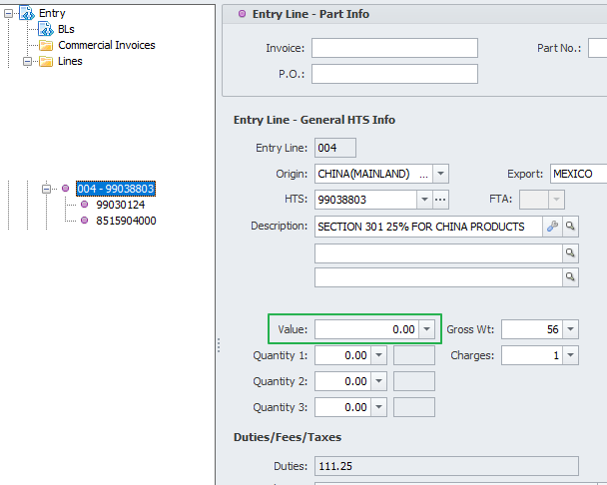
Scenario 4 - Section 301, Section IEEPA and 1-97 HTS CN Origin
CN Section 301 HTS goes first
Value will be 0

Slide 12
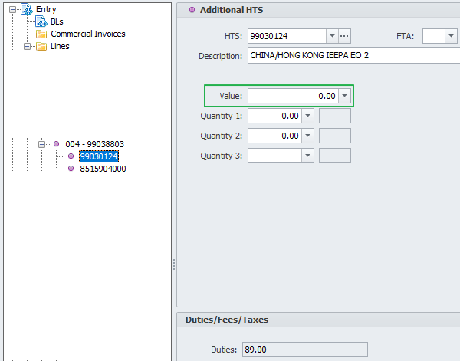
Scenario 4 - Section 301, Section IEEPA and 1-97 HTS CN Origin
CN Section IEEPA goes Second .
Please note that after 3/4/25 HTS 99030124 applies
Value is 0

Slide 13
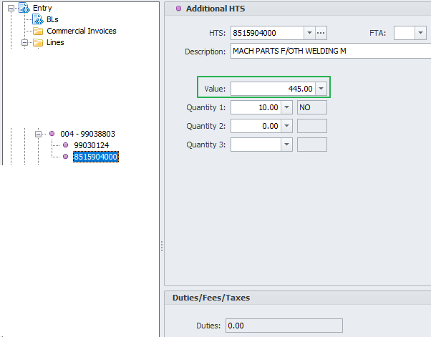
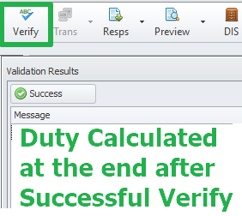
Scenario 4 - Section 301, Section IEEPA and 1-97 HTS CN Origin
1-97 HTS goes last
Include value

Slide 14
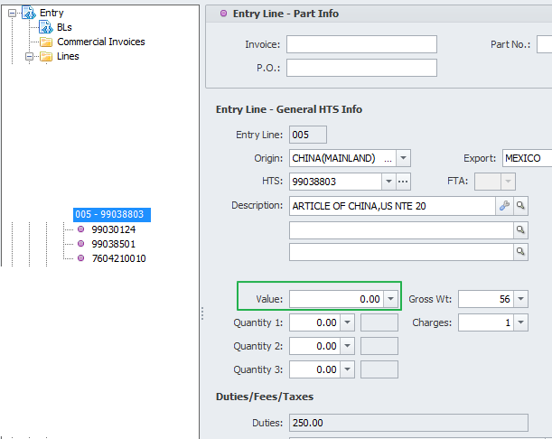
Scenario 5 - Section 301, Section IEEPA, Section 232, and 1-97 HTS CN Origin
CN Section 301 HTS is first
Value is 0

Slide 15
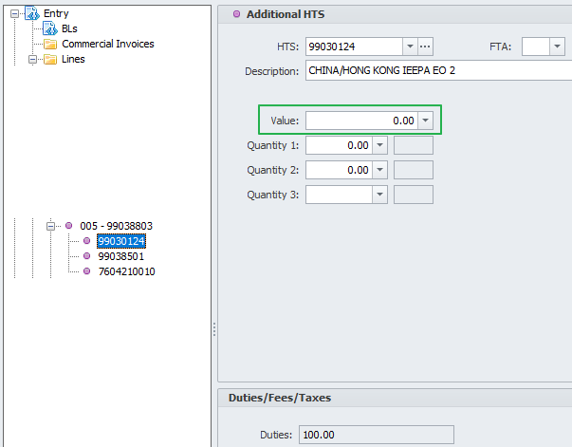
Scenario 5 - Section 301, Section IEEPA, Section 232, and 1-97 HTS CN Origin
CN Section IEEPA goes Second .
Please note that after 3/4/25 HTS 99030124 applies
Value is 0

Slide 16
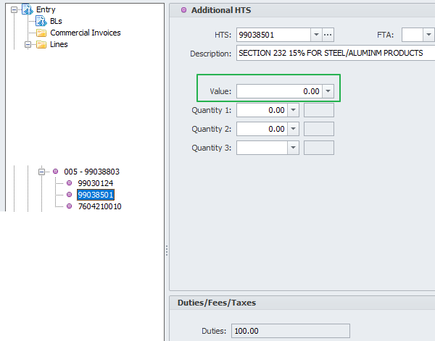
Scenario 5 - Section 301, Section IEEPA, Section 232, and 1-97 HTS CN Origin
Section 232 HTS is third
Value is 0

Slide 17
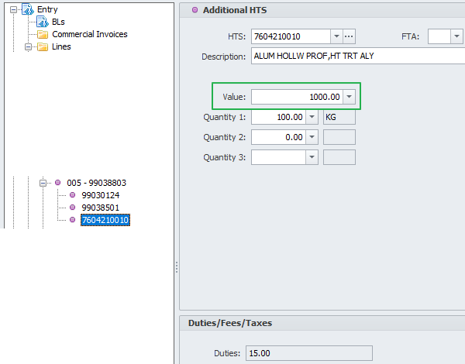
Scenario 5 - Section 301, Section IEEPA, Section 232, and 1-97 HTS CN Origin
1-97 HTS is last
Value is included

Slide 18
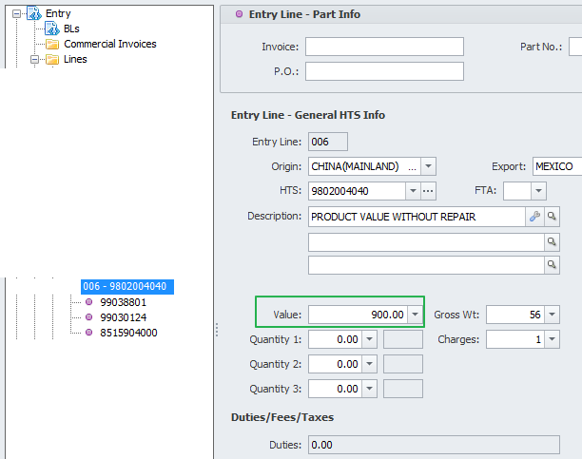
Scenario 6 – Repair 98020040/50 , Section 301, Section IEEPA, 1-97 HTS Dutiable Repair CN Origin
9802 repair HTS goes first
Must include Value of product excluding repair value

Slide 19
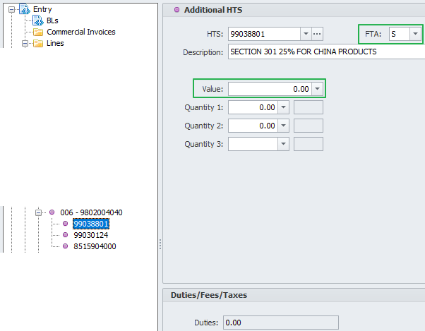
Scenario 6 – Repair 98020040/50 , Section 301, Section IEEPA, 1-97 HTS Dutiable Repair CN Origin
Section 301 goes second
Section 301 Value is 0
If Repairs done in MX or CA, FTA “S” may be applicable to avoid Section 301 duty

Slide 20
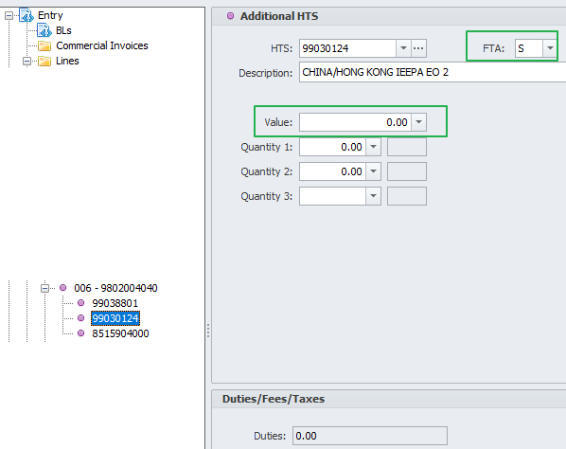
Scenario 6 – Repair 98020040/50 , Section 301, Section IEEPA, 1-97 HTS Dutiable Repair CN Origin
Section IEEPA goes Third
Value is 0
If Repair done on MX or CA, FTA “S” might be applicable

Slide 21
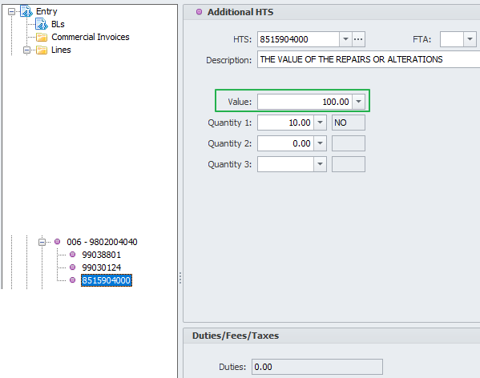
Scenario 6 – Repair 98020040/50 , Section 301, Section IEEPA, 1-97 HTS Dutiable Repair CN Origin
1-97 HTS goes last
Must include Repair value
Do not include FTA, duty must be calculated.

Slide 22
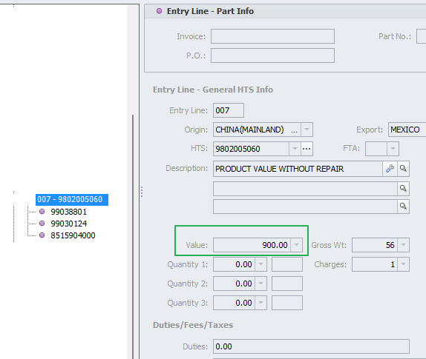
Scenario 7 – Further Processing 980200/50/60/80 , Section 301, Section IEEPA, 1-97 HTS Dutiable CN Origin
9802 HTS assembly is first
Include non dutiable Value of product without processing.

Slide 23
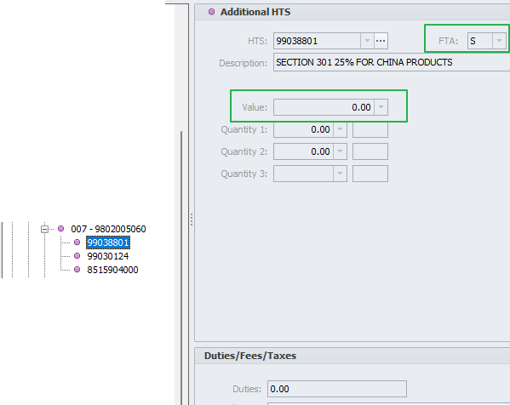
Scenario 7 – Further Processing 98020050/60/80 , Section 301, Section IEEPA, 1-97 HTS Dutiable CN Orign
CN Section 301 goes second
Section 301 Value is 0
If Further Processing done in MX or CA, FTA “S” may be applicable to avoid Section 301 duty

Slide 24
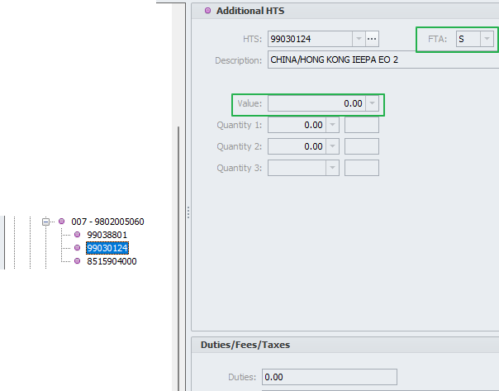
Scenario 7 – Further Processing 98020050/60/80 , Section 301, Section IEEPA, 1-97 HTS Dutiable CN Origin
CN Section IEEPA is third
Value must be 0
If Further Processing done in MX or CA, FTA “S” may be applicable to avoid Section IEEPA duty

Slide 25
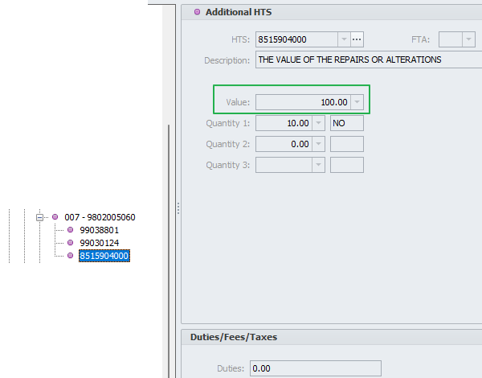
Scenario 7 – Further Processing 98020050/60/80 , Section 301, Section IEEPA, 1-97 HTS Dutiable CN Origin
1-97 HTS is last
Processing Assembly dutiable value is included
FTA does not apply on CN dutiable assembly line

Slide 26
Thank You

